Slide 1

Welcome to your...
Final project Survival game – Save Rabbits from Tigers
Object Oriented Programming
Fall 2020
Seon Joo Kim
Yonsei University
1

Slide 2
Outline
Deadline
No Plagiarism
Leave Comments
Scoring
Submission
Questions

Slide 3
Deadline
Tuesday, December 22 23:55
No late submissions at all

Slide 4
No Plagiarism
No Mercy.
The punishment will be made to both
the person who copied the code, and the person who shared the code.
We will do plagiarism test with codes that were made in previous semesters also in google. So be careful ☺

Slide 5
Leave Comments
Leave comments in your file for TAs to understand your code.
If no comments in the file, there may be a reduction of points.

Slide 6
No Skeleton Code / TAs’ Comments
Throughout this course, you have learned enough materials to materialize the final project
No skeleton code → more freedom of implementation
This is likely the first and last “project” scale assignment
We can definitely say that once you finish this project perfectly by your own, your coding skills will boost up and much thorough understanding of OOP will be possible
Even TAs take several hours to fully finish this project, so start immediately
We recommend you to design how to implement first, rather than just start coding without any plan

Slide 7
Scoring
130 points
(10pt) Grass generation / deletion fully implemented
(10pt) Food generation / deletion fully implemented
(10pt) Hunter move fully implemented
(10pt) Hunter shoot fully implemented
(10pt) Hunter life count / eat fully implemented
(10pt) Rabbit move fully implemented
(10pt) Rabbit breed fully implemented
(10pt) Rabbit life count / eat fully implemented
(10pt) Tiger move fully implemented
(10pt) Tiger breed fully implemented
(10pt) Tiger life count / eat fully implemented
(20pt) Minor details fully implemented
Bonus 30 points
no STL (vector, unordered_map, ...etc) used → +20 points
no heuristic initialization such as (Rabbit* rabbit[999999]) exists → +10 points
→ Maximum 160 points

Slide 8
Problem – Survival Game
Goal : Survive and Save Rabbits from Tigers!
if hunter dies or all rabbits die → you lose, Game over
if one or more rabbits alive and all tigers are dead
→ you win, Game finishes
Simulation of survival game
Character
Hunter
Tiger
Rabbit
Grass
World
W x H grid cells (1 <= W <= 1000, 1 <= H <= 1000)
One critter only can occupy a cell at a time
Critter can’t get out of given world

Slide 9
Problem – Survival Game
Simulation Space
W
 | T
 |  |  |  | H
 |  | R
 |  |  |  | F
 |  |  | *
H
H : Hunter
T : Tiger
R : Rabbit
* : Grass
F : Food

Slide 10
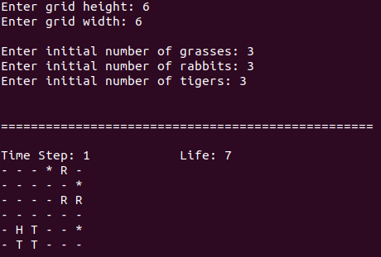
Problem – Survival Game
Initialization

Slide 11
Problem – Survival Game
Initialization
Conditions
grid height : H (1 <= H <= 1000)
grid width : W (1 <= W <= 1000)
number of grasses : G (G >= 0)
number of rabbits : R (R >= 1)
number of tigers : T (T >= 1)
(G+R+T+1 <= H x W)

Slide 12
Problem – Survival Game
Hunter’s action
Input is received as follows
Move (Command : 0)
User can move the hunter
Command
0 : ‘Up’, 1: ‘Down’, 2 : ‘Right’, 3 : ‘Left’
Shoot (Command : 1)
User can shoot
Command
0 : ‘Up’, 1: ‘Down’, 2 : ‘Right’, 3 : ‘Left’

Slide 13
Problem – Survival Game
Hunter’s action
Move (Command : 0)
User can move the hunter
Command
0 : ‘Up’, 1: ‘Down’, 2 : ‘Right’, 3 : ‘Left’
If user makes Hunter to move to the cell of either Tiger and Rabbit, Hunter is blocked by the animal and can’t move.
Grass does not block the Hunter’s move and Grass stays alive even if Hunter steps on it.
If user makes Hunter to move to the cell of Food, Hunter’s life recovers to the maximum life.
If user makes Hunter to move to the outside of grid cells, Hunter can’t move.

Slide 14
Problem – Survival Game
Move examples
 |  | H
 |  | H
 |  | *
 | F | H | R
 |  | T
available cell
(move)
available cell
(move)
available cell
(move)

Slide 15
Problem – Survival Game
Hunter’s action
Shoot (Command : 1)
User can shoot
Command
0 : ‘Up’, 1: ‘Down’, 2 : ‘Right’, 3 : ‘Left’
If Hunter shoots, the animal closest to that direction becomes Food.
If user makes Hunter to shoot the cell of either Rabbit or Tiger, the animal is killed by Hunter and becomes Food.
If user makes Hunter to shoot in the direction where no animals exist, nothing happens.

Slide 16
 |  |  | *
R | H |  | R | T
 | T
 |  |  |  | *
Shoot examples
shoot up
 |  |  | *
F | H |  | R | T
 | T
 |  |  |  | *
 |  |  | *
R | H |  | R | T
 | T
 |  |  |  | *
 |  |  | *
R | H |  | F | T
 | T
 |  |  |  | *
shoot left
shoot right
shoot down
 |  |  | *
R | H |  | R | T
 | F
 |  |  |  | *

Slide 17
Problem – Survival Game
Hunter’s attribute
Life
Hunter’s starting life is 7.
Life will decrease by one at each step.
If user makes Hunter to move to the cell of Food, Hunter’s life recovers to full life (7).
Game over conditions
If life becomes zero, the game is over.
If Hunter moves to or stays at the cell where a Tiger is nearby, Hunter is eaten by the Tiger and the game is over.
Game win condition
If the number of Tigers reaches zero, the game ends with a win.

Slide 18
Problem – Survival Game
Grass generation
Grass generation
At the start of the game, grasses are created with a random position as many grasses as the number of grasses received as input.
At each step, grasses are generated by a 10% probability in an empty cell (no Food, no Rabbit, no Tiger, no Hunter).
Grass conditions
If Rabbit moves to the cell with Grass, Grass is eaten by the Rabbit and Grass disappears. Also, Rabbit’s life recovers to full life.
If Tiger or Hunter moves to the cell of Grass, nothing happens. Next time the Tiger moves elsewhere, the Grass stays where it was.
If Food is generated on a cell, the Grass on the cell disappears and only the Food remains.

Slide 19
Problem – Survival Game
Grass examples
move
down
shoot
right
move
right
move
right
T | * |  | R | *
 | H
 | * | *
 |  | T
 | T |  |  | R
 | H | T
 | * | T
 |  |  |  | R
 | H | F
 | *
 |  | T | R
 |  | H
 | *
 |  |  | T
 |  |  | H
- Rabbit eats grass
Grass remains
Grass disappears
Tiger becomes food
Hunter eats food
Grass disappears
Tiger eats rabbit

Slide 20
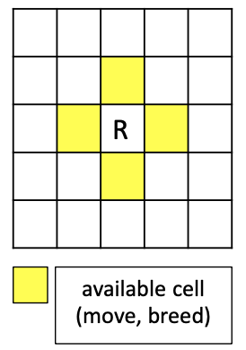
Problem – Survival Game
Rabbit’s action
move
At every time step, move randomly
Up, down, left, right
If all neighboring cells are occupied by other animals or out of the world
Stay in the current cell
rabbit can stand on the food. In this case, food is obscured by the rabbit. (rabbit cannot eat food)
If there are grasses in adjacent cells
A rabbit will randomly move to one of those cells and eat a grass
breed
If the rabbit is alive every 7 steps (7,14,21,...), then it does not move and breeds a child at the end of the time step
Creates a new rabbit in a random adjacent cell which is empty(= no other animals)
rabbit can breed in grass/food cell.
No empty cell, no breeding occurs
It has to wait until the next 7 turn

Slide 21
Problem – Survival Game
Rabbit’s attribute
Life
Rabbit’s starting life is 5.
Life will decrease by one at each step.
If a rabbit moves to the cell of grass, rabbit’s life recovers to full life (5).
If a rabbit has not eaten a grass within the last five time steps, the rabbit will die before moving.
If breeding and starvation occur at the same time, a rabbit does not breed but die

Slide 22
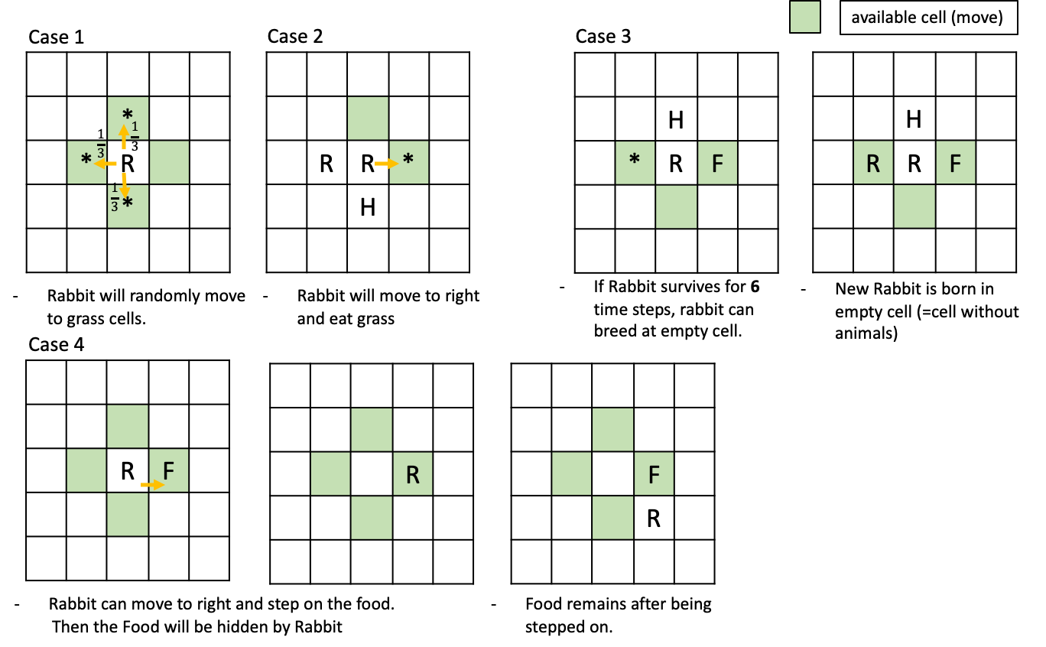
Problem – Survival Game
Rabbit examples

Slide 23
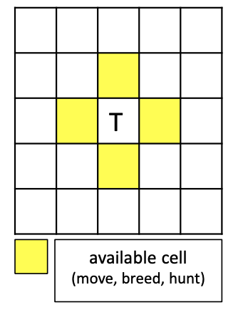
Problem – Survival Game
Tiger’s action
move
At every time step, move randomly
Up, down, left, right
tiger can stand on the grass / food. In this case, grass / food is obscured by the tiger. (tiger can’t eat grass and food)
If all neighboring cells are occupied by other tigers or out of the world
Stay in the current cell
Tigers do not eat each other
If there are different types animals in adjacent cells
A tiger will randomly move to one of those cells and eat it
If both rabbit and hunter are in neighboring cells, Tiger will attack hunter first. → (Hunter dies == Game Over)

Slide 24
Problem – Survival Game
Tiger’s action
breed
If the tiger is alive every 10 steps (10,20,...),
Spawn off a new tiger in the same manner as rabbits
No empty cell, no breeding occurs
It has to wait for the next 10 turn
Tiger’s attribute
Life
Tiger’s starting life is 7.
Life will decrease by one at each step.
If a tiger eats a rabbit, tiger’s life recovers to full life (7).
If a tiger has not eaten a rabbit within the last seven time steps, the tiger will die before moving.
If breeding and starvation occur at the same time, a tiger does not breed but die

Slide 25
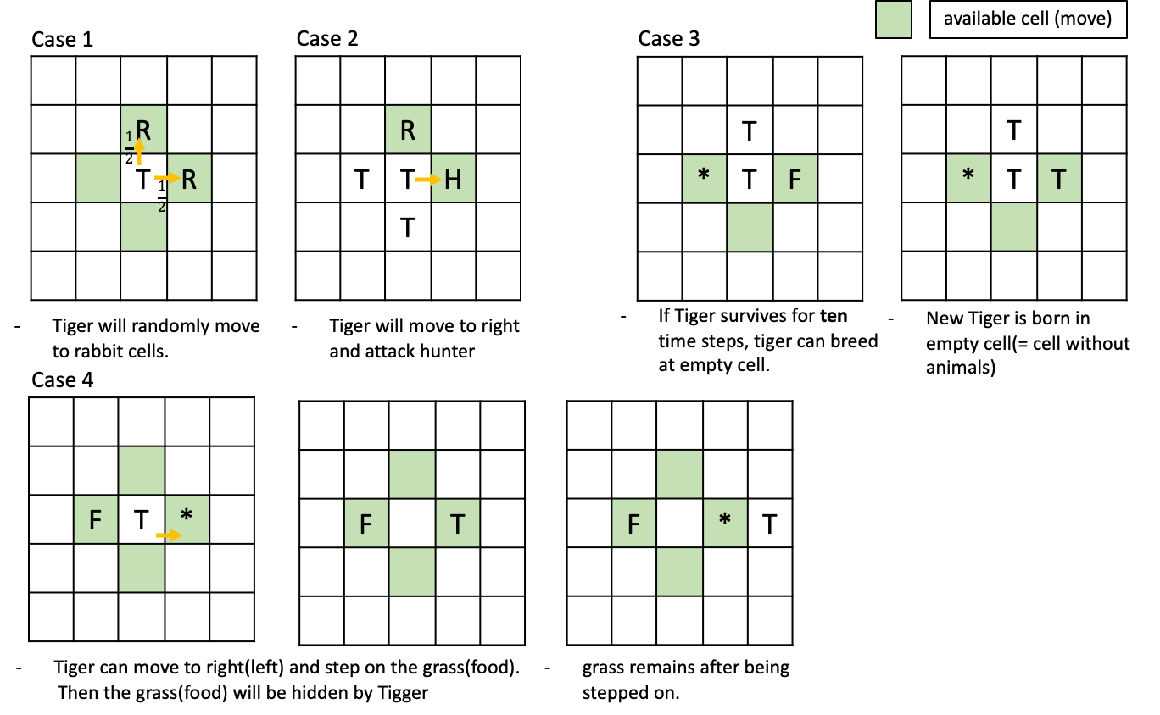
Problem – Survival Game
Tiger examples
9

Slide 26
Problem – Survival Game
Task specifications
Action priority
Hunter’s action → Tiger’s action → Rabbit’s action → Grass generation
Action sequences
Each critter’s action is carried out from the top left to the bottom right.
1 | 2 | 3
4 | 5 | 6
7 | 8 | 9
Example
Command : move left
T | R
* |  | T
R |  | H
T | R
* |  | T
R | H
 | T
* |  | T
R | H
 | T | T
*
R | H
 | T
R |  | T
 | H
* | T
 |  | T
 | H
- Initial state
- Hunter moves left
- Tiger eats rabbit
- Tiger moves up
- Rabbit eats grass
- Grass generates

Slide 27
Submission
Zip the folder by following steps correctly
studentId_final.tar.gz
Ex) 2020123456_final.tar.gz
There is going to be reduction of points if not following the folder hierarchy as well
When unzip your submission to .tar.gz file, you should follow the folder hierarchy below
Current directory
- studentId_final.tar.gz
- studentId_final
- all your files

Slide 28
Questions
Use oop20202@gmail.com for questions
We are not going to answer
Questions sent to TAs’ personal mails
Questions not making sense
Questions related to the algorithm for solving the question
Questions you can infer the answer if read this file thoroughly
Questions you can simply solve by googling
Ex) how do I make a folder on ubuntu?

